Slide 1
Philippians 2:12-18
Why Obedience Matters!
Preached by Dan Bridges Amman International Church, Jordan (AmmanChurch.org) Uploaded by Dr. Rick Griffith • Jordan Evangelical Theological Seminary Files in many languages for free download at BibleStudyDownloads.org

Slide 2
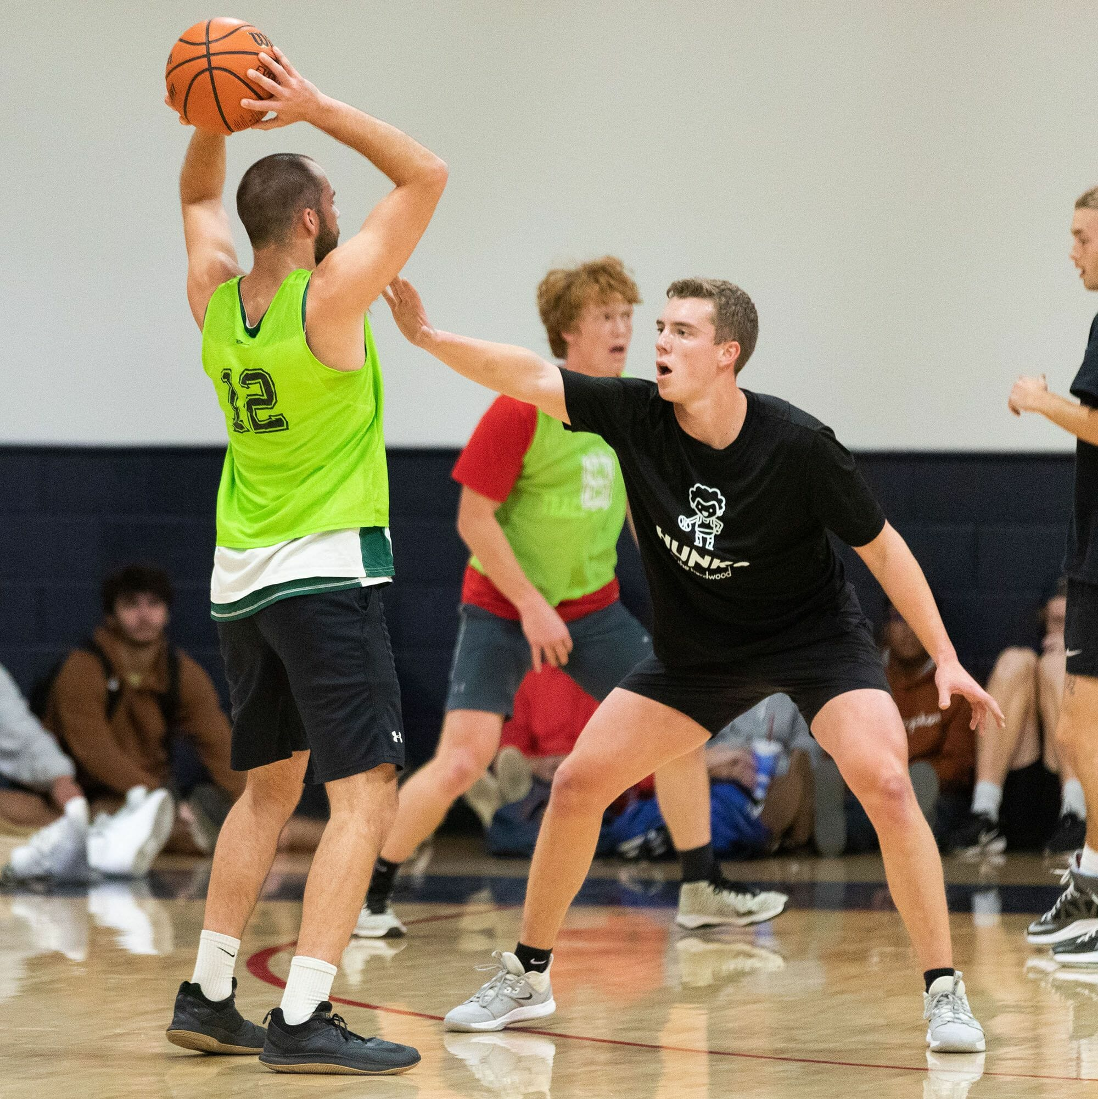
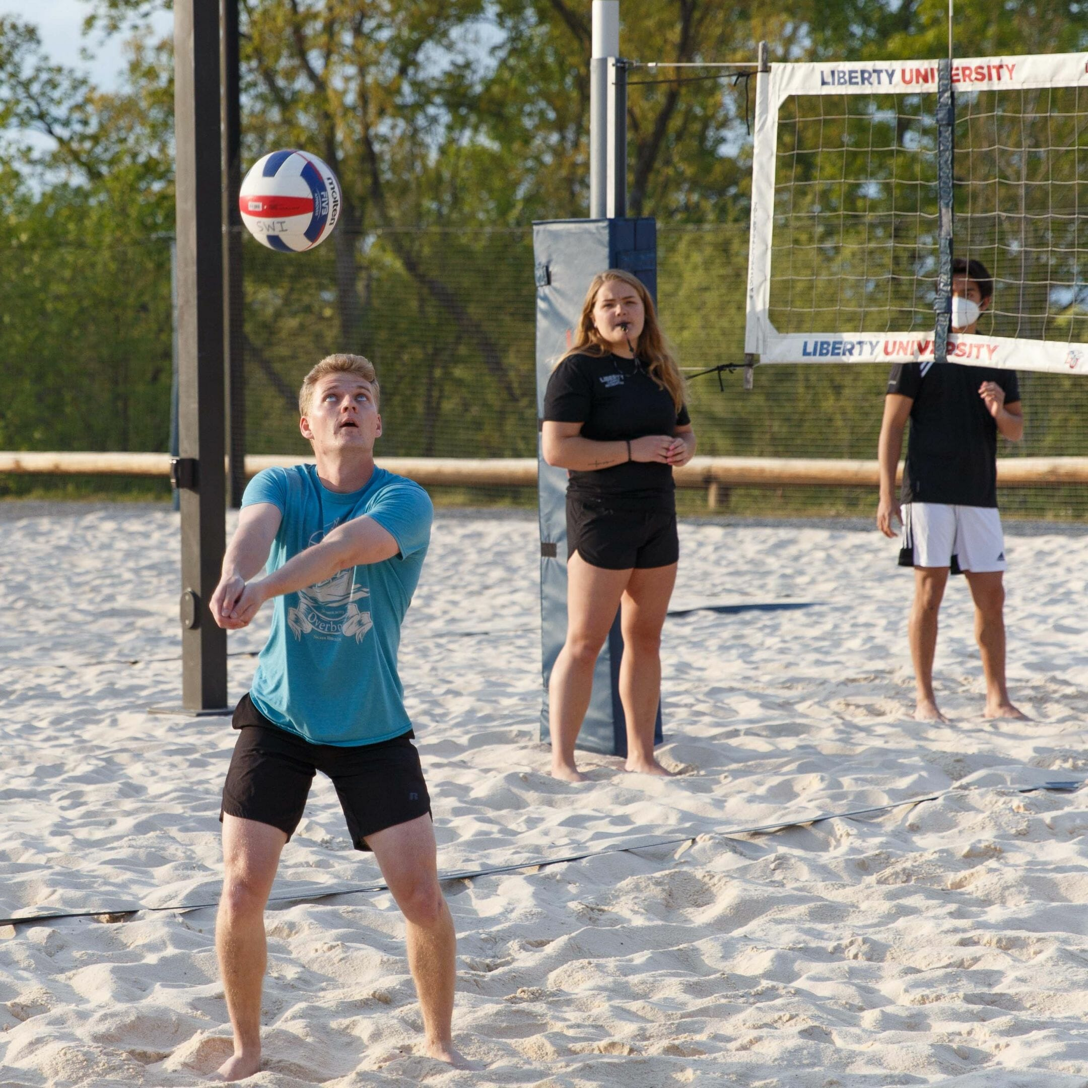
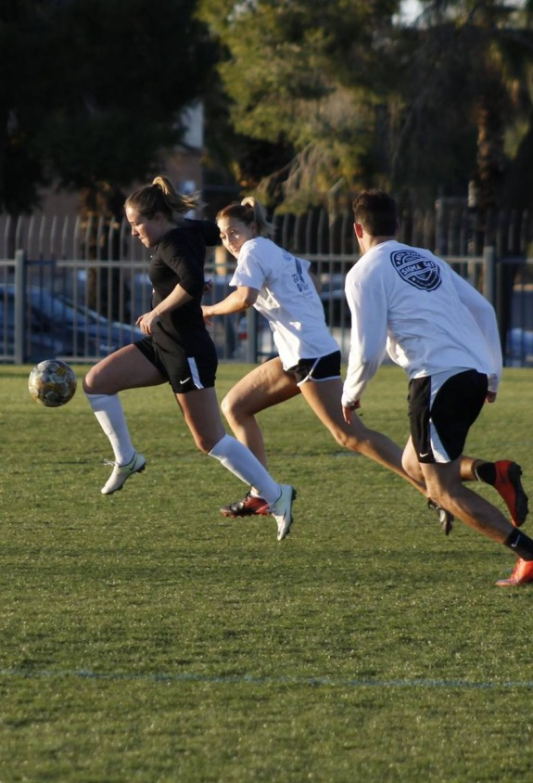
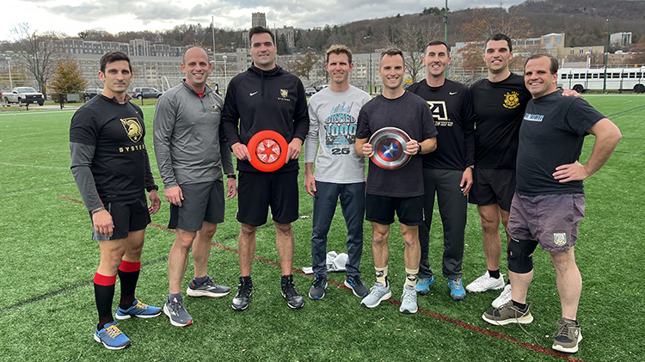
Varsity Sports
Intramural Sports

Slide 3
Intramural Sports
Varsity Sports
Just for fun
Little/No practice
Spare time
Depend on old skills
Serious
Tons of practice
Main priority
Always improving
Is our approach to obedience more like an intramural sport or a varsity sport?

Slide 4
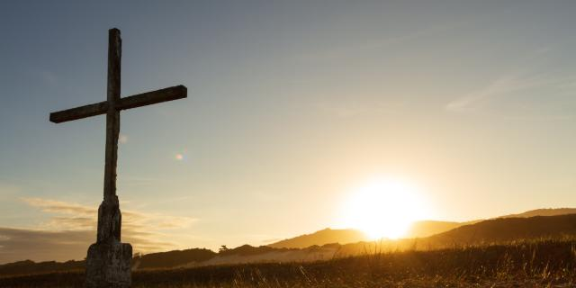
Lives Worthy of the Gospel (1:27)
Relating with the unbelievers (1:27-30)
Relating with believers (2:1-4)
Attitude of Christ (2:5-11)
Summary: Appeal to Obedience – To Christlikeness (2:12-18)

Slide 5
¹² Therefore, my beloved, as you have always obeyed, so now, not only as in my presence but much more in my absence, work out your own salvation with fear and trembling, ¹³ for it is God who works in you, both to will and to work for his good pleasure.
Philippians 2:12-13

Slide 6
¹⁴ Do all things without grumbling or disputing, ¹⁵ that you may be blameless and innocent, children of God without blemish in the midst of a crooked and twisted generation, among whom you shine as lights in the world, ¹⁶ holding fast to the word of life, so that in the day of Christ I may be proud that I did not run in vain or labor in vain. ¹⁷ Even if I am to be poured out as a drink offering upon the sacrificial offering of your faith, I am glad and rejoice with you all. ¹⁸ Likewise you also should be glad and rejoice with me. Phil. 2:14-18

Slide 7
Why does Obedience Matter?
It’s what We are Called To (12-13)
It’s the Main Key to Evangelism (14-16)
It has Eternal Impact (17-18)

Slide 8
Obedience is What We are Called To
¹² Therefore, my beloved, as you have always obeyed, so now, not only as in my presence but much more in my absence, work out your own salvation with fear and trembling, ¹³ for it is God who works in you, both to will and to work for his good pleasure.
Philippians 2:12-13
vss 6-11 – In view of the example
Christ has set for us

Slide 9
Obedience is What We are Called To
¹² Therefore, my beloved, as you have always obeyed, so now, not only as in my presence but much more in my absence, work out your own salvation with fear and trembling, ¹³ for it is God who works in you, both to will and to work for his good pleasure.
Philippians 2:12-13

Slide 10
Obedience is What We are Called To
¹² Therefore, my beloved, as you have always obeyed, so now, not only as in my presence but much more in my absence, work out your own salvation with fear and trembling, ¹³ for it is God who works in you, both to will and to work for his good pleasure.
Philippians 2:12-13

Slide 11
Work Out Your Own Salvation???
Context: Obey – Even when I’m not there
Does not mean “Work FOR your own salvation”
Phil. 1:1 He calls them “saints” – they are already believers
Eternal salvation is a work of God – not man (God “opened” Lydia’s heart – Acts 16:14)

Slide 12
Work Out Your Own Salvation???
“Work Out” – Greek word always has the idea of bringing something to completion
Example: Work out the math problem
Used in Paul’s day in mining (getting all the ore out) and in farming (getting all of the crops harvested)

Slide 13
Work Out Your Own Salvation???
Salvation is used in three ways in scripture:
Salvation from the Penalty of Sin
Salvation from the Power / Practice of Sin (Sanctification)
Salvation from the Presence of Sin (Glorification)

Slide 14
Obedience is What We are Called To
¹² Therefore, my beloved, as you have always obeyed, so now, not only as in my presence but much more in my absence, work out your own salvation with fear and trembling, ¹³ for it is God who works in you, both to will and to work for his good pleasure.
Philippians 2:12-13
Exhortation to carry out our salvation (sanctification) to its ultimate conclusion – Christlikeness!

Slide 15
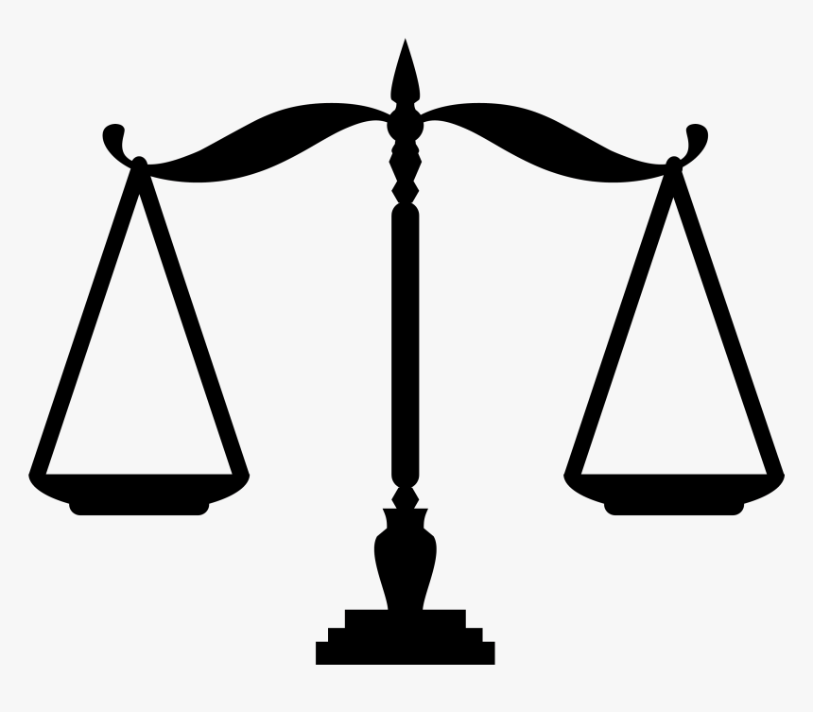
How do we Measure Our Obedience?
People around me
ME
Christ!
ME
Work Out = Bring to Completion!

Slide 16
Obedience is What We are Called To
¹² Therefore, my beloved, as you have always obeyed, so now, not only as in my presence but much more in my absence, work out your own salvation with fear and trembling, ¹³ for it is God who works in you, both to will and to work for his good pleasure.
Philippians 2:12-13
Self-distrust; Constant awareness of the deceitfulness of our own hearts

Slide 17
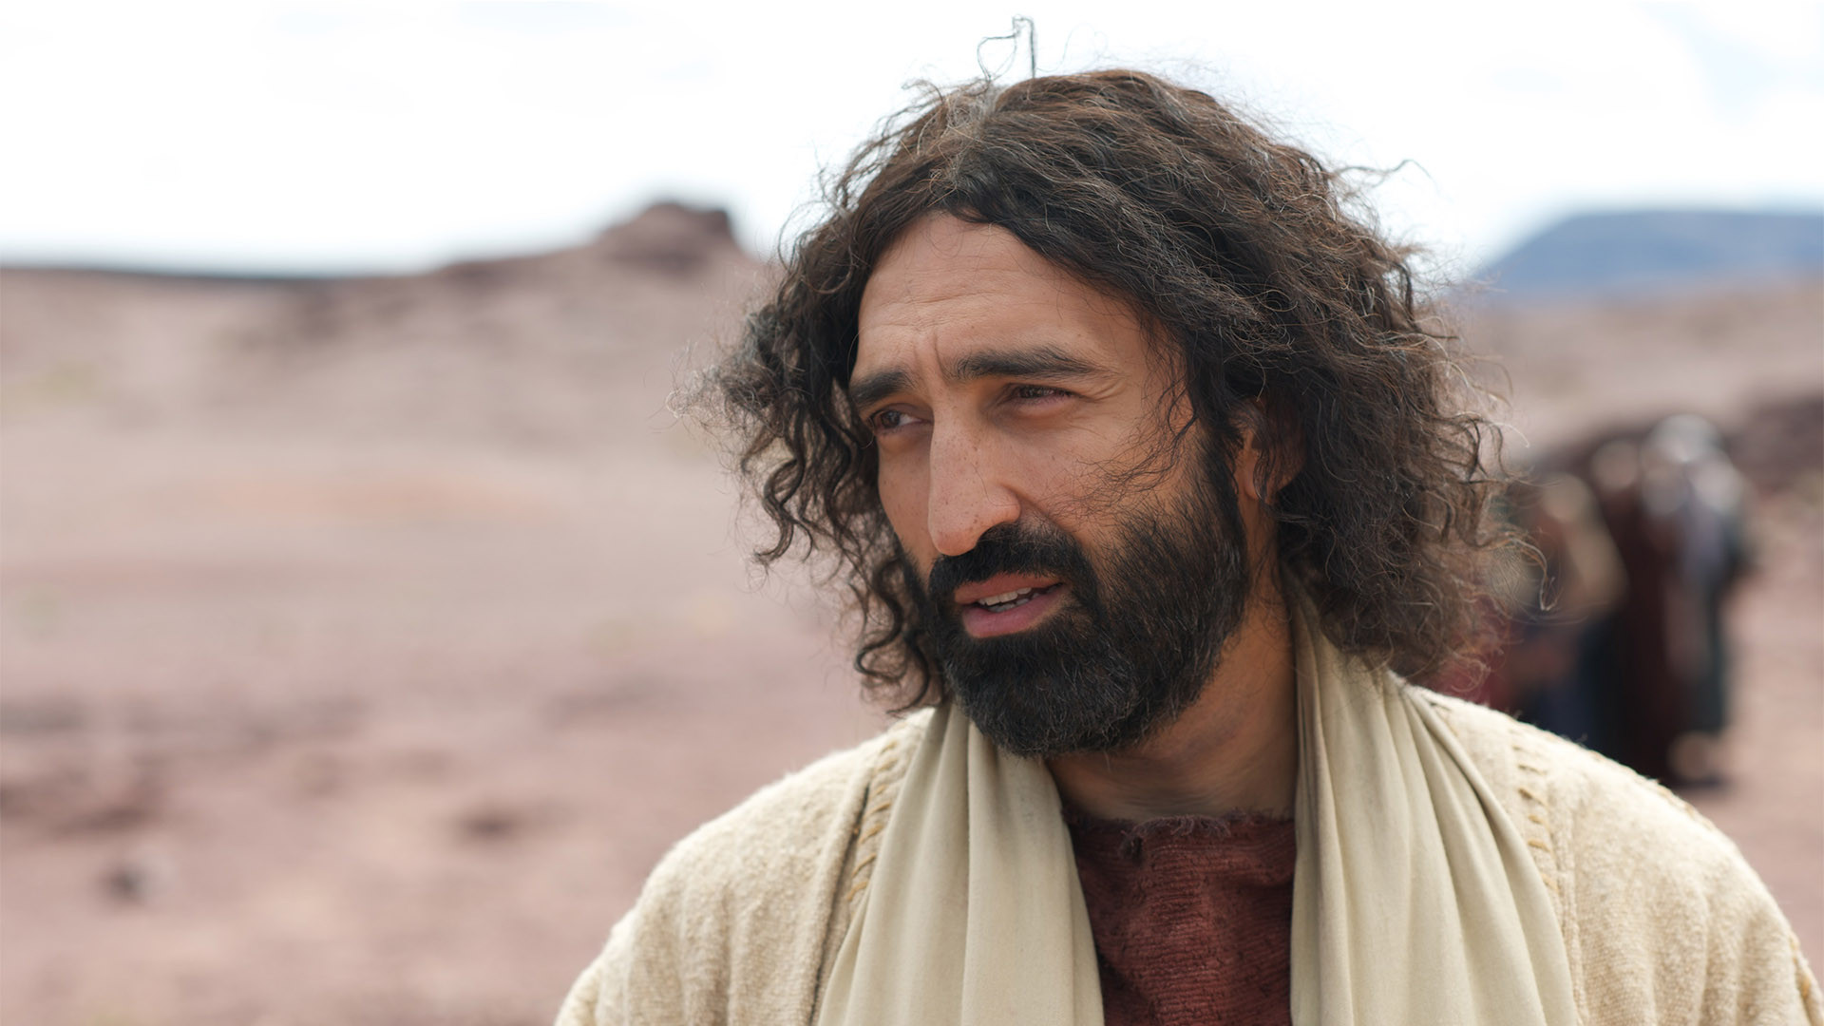
But how is this possible?
How can we really be Christlike?

Slide 18
Obedience is What We are Called To
¹² Therefore, my beloved, as you have always obeyed, so now, not only as in my presence but much more in my absence, work out your own salvation with fear and trembling, ¹³ for it is God who works in you, both to will and to work for his good pleasure.
Philippians 2:12-13
Bring to completion
Gk: energeo Produce an effect!

Slide 19
Obedience is What We are Called To
¹² Therefore, my beloved, as you have always obeyed, so now, not only as in my presence but much more in my absence, work out your own salvation with fear and trembling, ¹³ for it is God who works in you, both to will and to work for his good pleasure.
Philippians 2:12-13
God works in us
To give us a desire to obey
To enable us to obey

Slide 20
How does God Empower Us?
The Holy Spirit’s power in our lives comes through
His Word
Prayer
Suffering / Difficult times
Deep relationships with other believers

Slide 21
Obedience is What We are Called To
Vs 12 – Human Responsibility
Saying “No” to sin
Exerting the effort to do what is right
Vs 13 – Divine Enablement
The power of the Holy Spirit in our lives
“A Christlike life is not by imitation, but by incarnation (Christ lives in me – Galatians 2:20)”
Warren Weirsbe

Slide 22
Why does Obedience Matter?
It’s what We are Called To (12-13)
It’s the Main Key to Evangelism (14-16)
It has Eternal Impact (17-18)

Slide 23
¹⁴ Do all things without grumbling or disputing, ¹⁵ that you may be blameless and innocent, children of God without blemish in the midst of a crooked and twisted generation, among whom you shine as lights in the world, ¹⁶ holding fast to the word of life…
Phil. 2:14-16a
Why these particular sins?
UNITY!

Slide 24
¹⁴ Do all things without grumbling or disputing, ¹⁵ that you may be blameless and innocent, children of God without blemish in the midst of a crooked and twisted generation, among whom you shine as lights in the world, ¹⁶ holding fast to the word of life…
Phil. 2:14-16a
Why not grumble and dispute?

Slide 25
¹⁴ Do all things without grumbling or disputing, ¹⁵ that you may be blameless and innocent, children of God without blemish in the midst of a crooked and twisted generation, among whom you shine as lights in the world, ¹⁶ holding fast to the word of life…
Phil. 2:14-16a
Why not grumble and dispute?
In order to be lights in the world!

Slide 26
¹⁴ Do all things without grumbling or disputing, ¹⁵ that you may be blameless and innocent, children of God without blemish in the midst of a crooked and twisted generation, among whom you shine as lights in the world, ¹⁶ holding fast to the word of life…
Phil. 2:14-16a
What is the word of life?
The gospel!

Slide 27
So Why is Obedience the Main Key to Evangelism?
¹⁴ Do all things without grumbling or disputing, ¹⁵ that you may be blameless and innocent, children of God without blemish in the midst of a crooked and twisted generation, among whom you shine as lights in the world, ¹⁶ holding fast to the word of life…
Phil. 2:14-16a

Slide 28
So Why is Obedience the Main Key to Evangelism?
It is the testimony of our lives that gives power to the gospel message…
Humility
Selflessness
Forgiveness
Loving our enemies
Unity where it shouldn’t happen

Slide 29
So Why is Obedience the Main Key to Evangelism?
¹ Likewise, wives, be subject to your own husbands, so that even if some do not obey the word, they may be won without a word by the conduct of their wives, ² when they see your respectful and pure conduct.
1 Peter 3:1-2

Slide 30
Why does Obedience Matter?
It’s what We are Called To (12-13)
It’s the Main Key to Evangelism (14-16)
It has Eternal Impact (17-18)

Slide 31
It has Eternal Impact!
…among whom you shine as lights in the world, ¹⁶ holding fast to the word of life, so that in the day of Christ I may be proud that I did not run in vain or labor in vain. ¹⁷ Even if I am to be poured out as a drink offering upon the sacrificial offering of your faith, I am glad and rejoice with you all. ¹⁸ Likewise you also should be glad and rejoice with me. Phil. 2:14-18
So that I may exult!
Why this conclusion to the call to obedience?

Slide 32
It has Eternal Impact!
If in Christ we have hope in this life only, we are of all people most to be pitied.
1 Corinthians 15:19
The ultimate payoff for obedience is not in this life!

Slide 33
…among whom you shine as lights in the world, ¹⁶ holding fast to the word of life, so that in the day of Christ I may be proud that I did not run in vain or labor in vain. ¹⁷ Even if I am to be poured out as a drink offering upon the sacrificial offering of your faith, I am glad and rejoice with you all. ¹⁸ Likewise you also should be glad and rejoice with me. Phil. 2:14-18
Both Paul and the Philippians were paying dearly for their faith and their obedience…
So why rejoice???

Slide 34
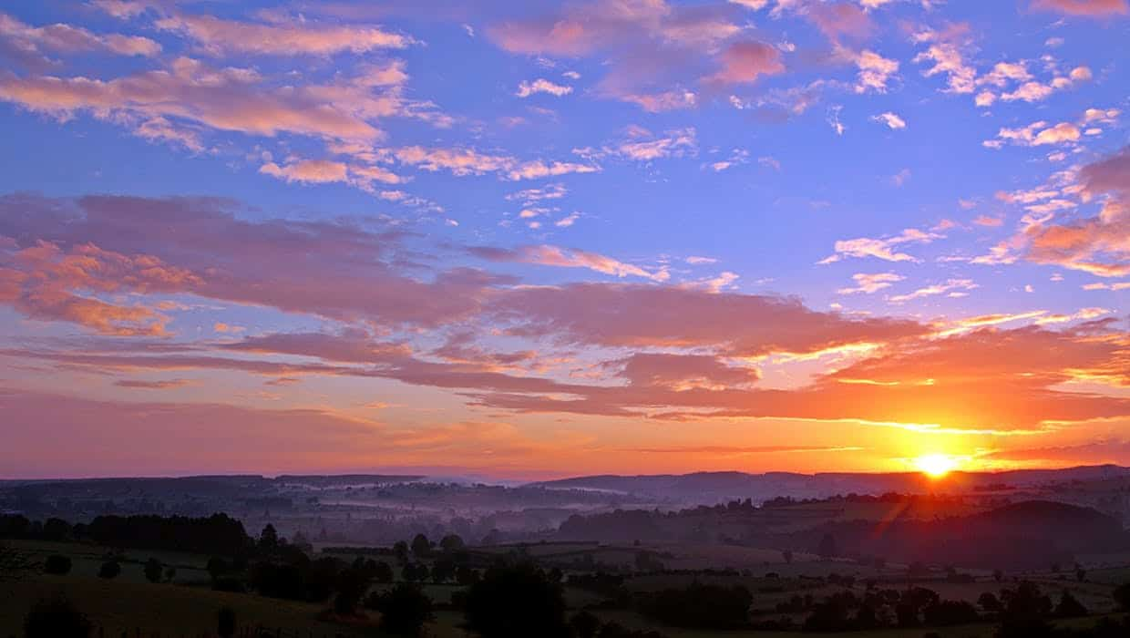
⁹ Therefore God exalted him to the highest place and gave him the name that is above every name, ¹⁰ that at the name of Jesus every knee should bow, in heaven and on earth and under the earth, ¹¹ and every tongue acknowledge that Jesus Christ is Lord, to the glory of God the Father.
Philippians 2:9-11

Slide 35
…among whom you shine as lights in the world, ¹⁶ holding fast to the word of life, so that in the day of Christ I may be proud that I did not run in vain or labor in vain. ¹⁷ Even if I am to be poured out as a drink offering upon the sacrificial offering of your faith, I am glad and rejoice with you all. ¹⁸ Likewise you also should be glad and rejoice with me. Phil. 2:14-18
Obedience brings eternal reward, joy and exaltation. But do we really believe that?

Slide 36
Why does Obedience Matter?
It’s what We are Called To (12-13)
It’s the Main Key to Evangelism (14-16)
It has Eternal Impact (17-18)

Slide 37
Questions for Thought…
Are we growing in obedience or relying on our previous growth?
Who is our standard for obedience?
What does the testimony of our lives tell the world about the gospel?
How much does the promise of eternal reward and joy affect our lives today?

Slide 38
Questions for Thought…
Are there sins we’re aware of?
If so, we know where to start!
If not, pray Psalm 139:23-24
²³ Search me, O God, and know my heart!
Try me and know my thoughts!
²⁴ And see if there be any grievous way in me,
and lead me in the way everlasting!

Slide 39
Why do we Train our Children in Obedience?
It’s for their good!
It’s for the good of others!
Because we love them deeply!

Slide 40
Why does God Train his Children in Obedience?
It’s for our good!
It’s for the good of others!
Because he loves us deeply!
For His Glory!

Slide 42
Old Testament References
Exodus 16:12
¹⁴ Do all things without grumbling or disputing, ¹⁵ that you may be blameless and innocent, children of God without blemish in the midst of a crooked and twisted generation, among whom you shine as lights in the world, ¹⁶ holding fast to the word of life…
Phil. 2:14-16a
Deuteronomy 32:5
Daniel 12:3
Notes:
Paul’s only other use of the word for grumbling is in 1 Cor 10:10 which refers directly to the grumbling of the Israelites. This word is used regularly in the Septuagint to refer to the grumbling of the Israelites.
The crooked and twisted generation comes from the Song of Moses describing the Israelites

Slide 44
NT Preaching link at BibleStudyDownloads.org
Get this presentation for free!
Notes:
NT Preaching (np)

